Slide 1

Applied Machine Learning - Week 14 Office Hours – Favio Vázquez

Slide 2
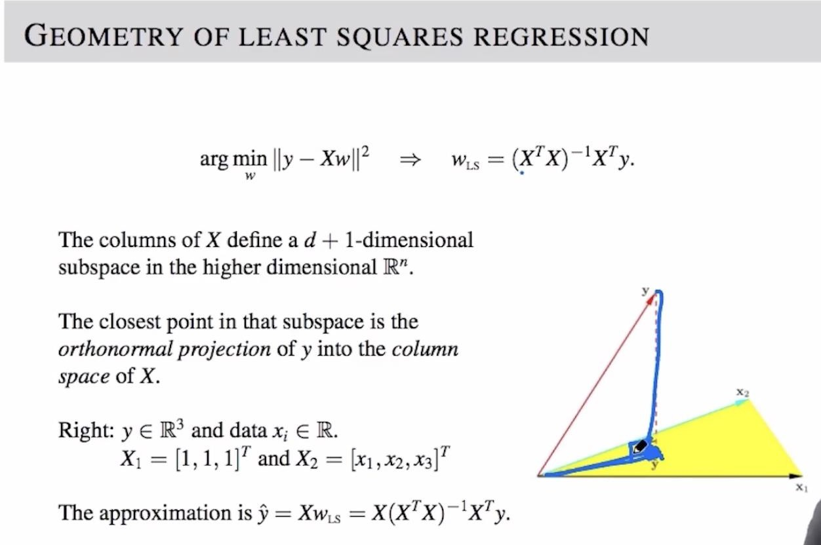
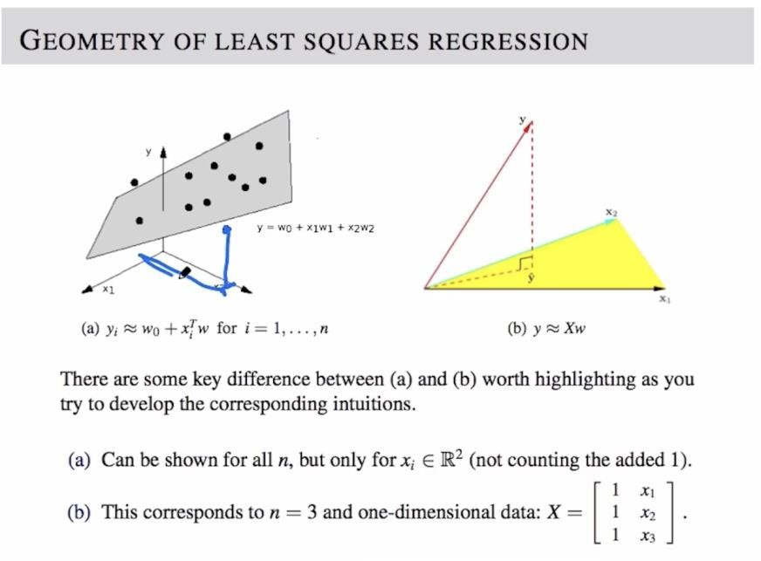
14.1 Geometry of Least Squares Regression

Slide 3
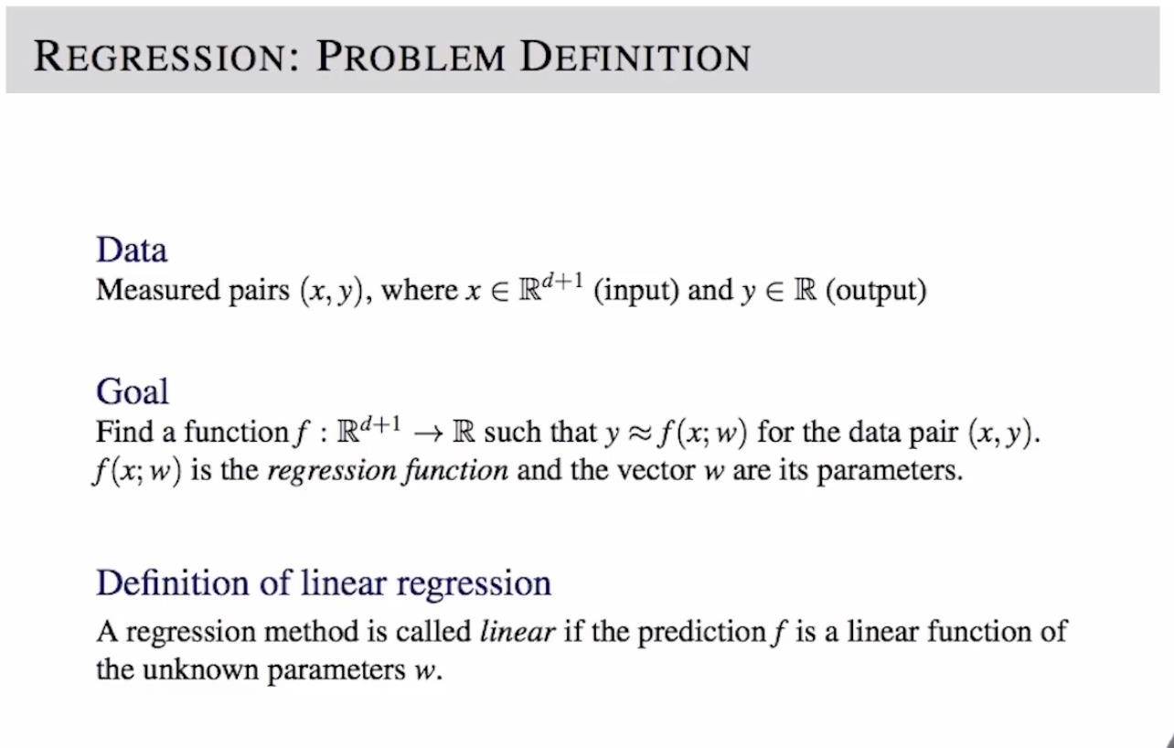
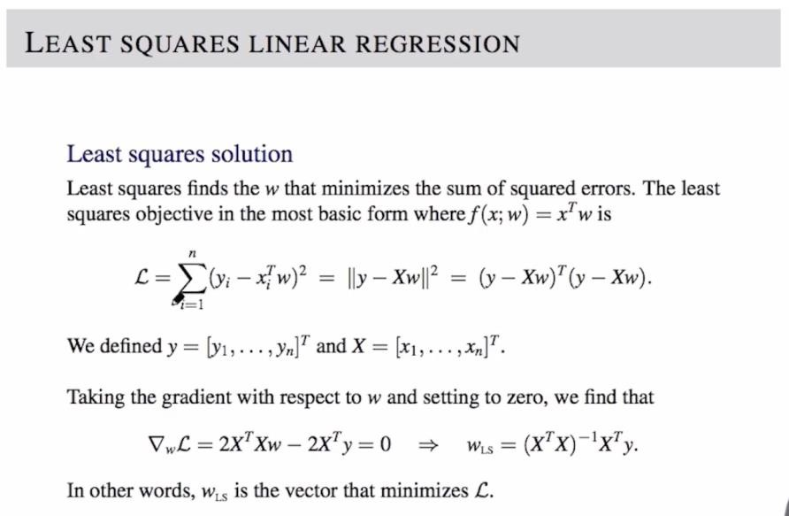
14.2 Least Squares Linear Regression

Slide 4
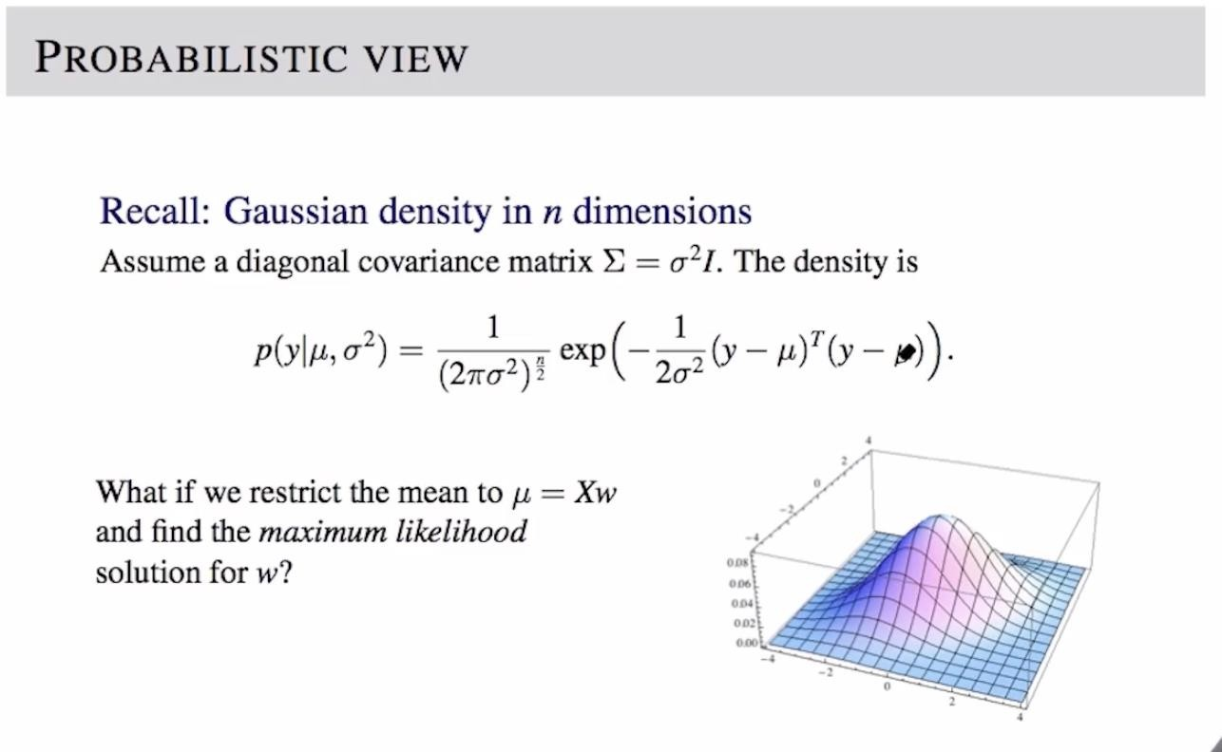
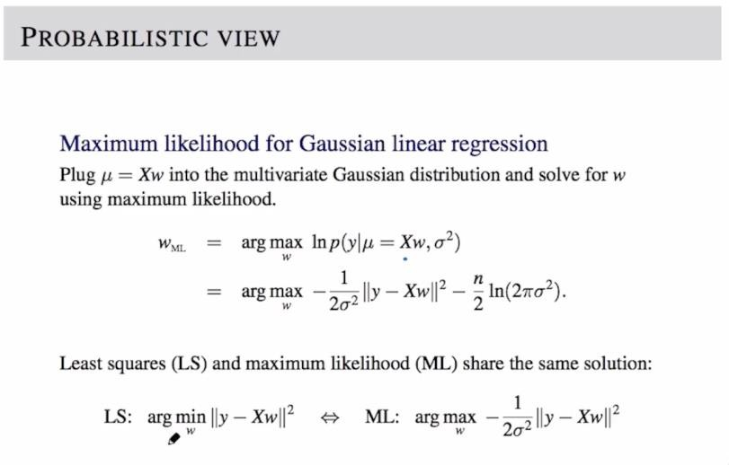
14.3 A Probabilistic View

Slide 5
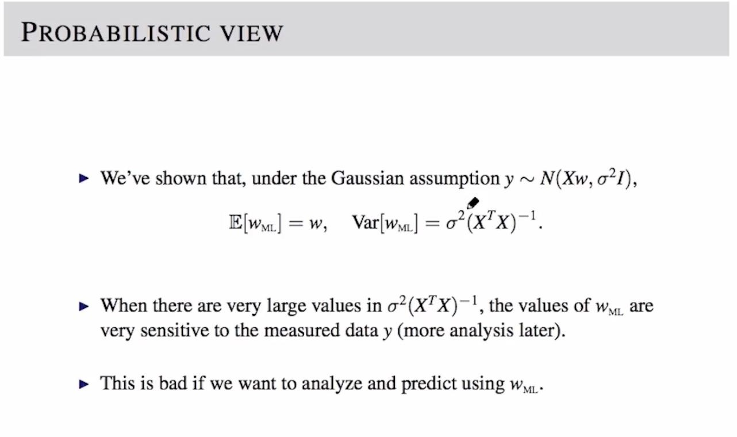
14.4 Review: An Equality from Probability

Slide 6
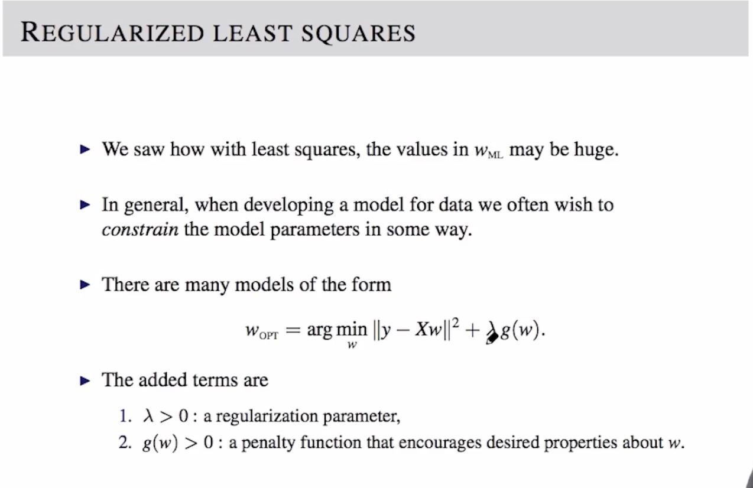
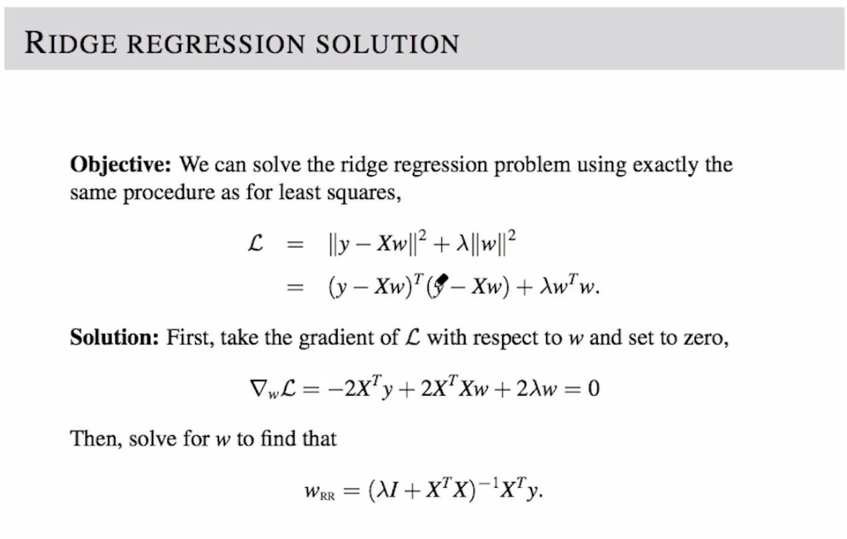
14.5 Ridge Regression

Slide 7
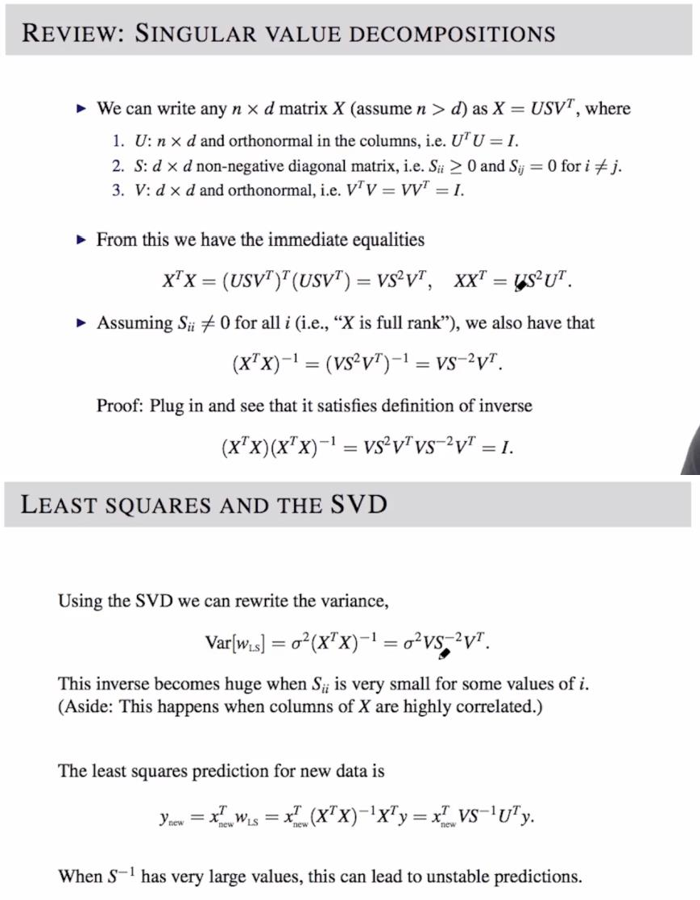
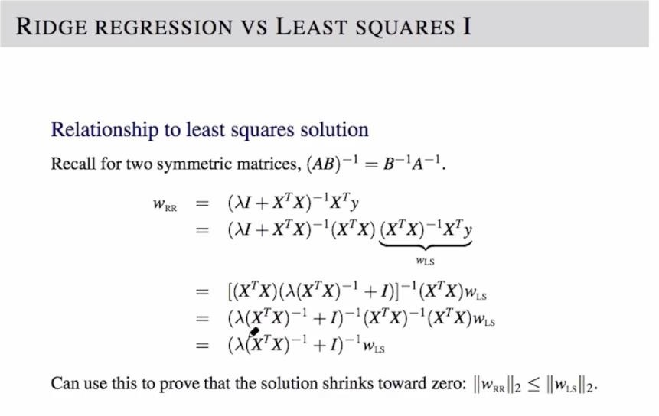
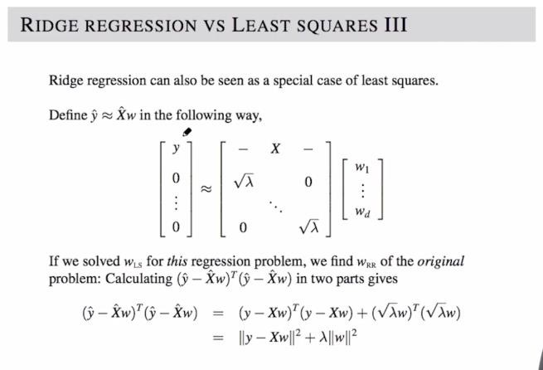
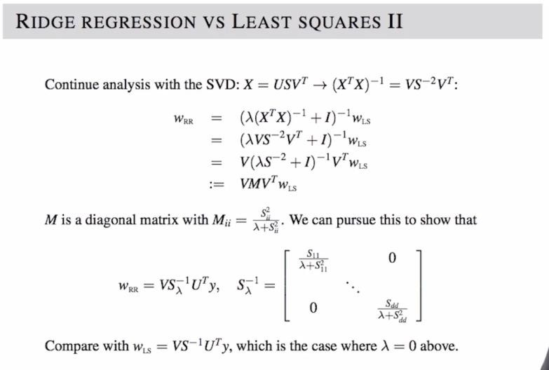
14.6-7 More Analysis of Ridge Regression I-II

Slide 8
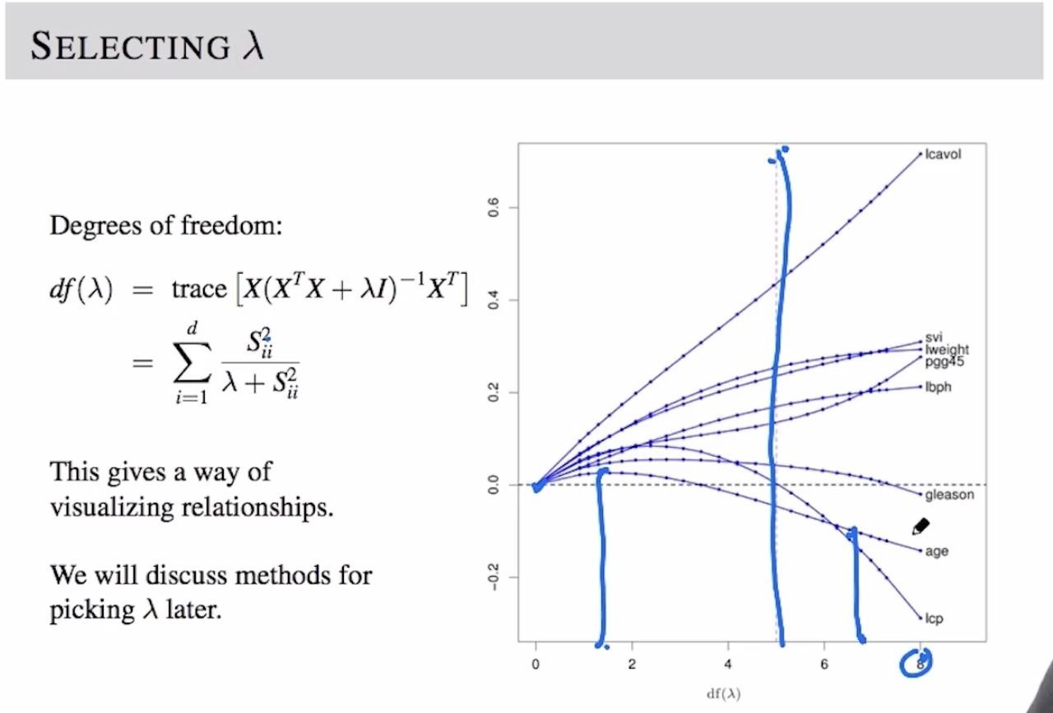
14.8 The Regularization Parameter

Slide 9
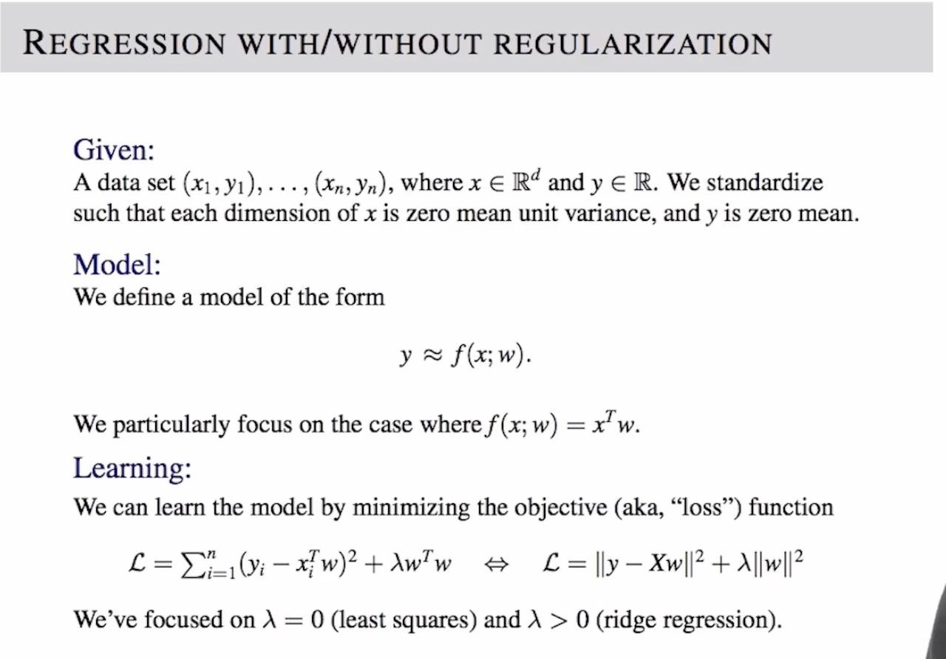
14.9 Regression With/Without Regularization

Slide 10
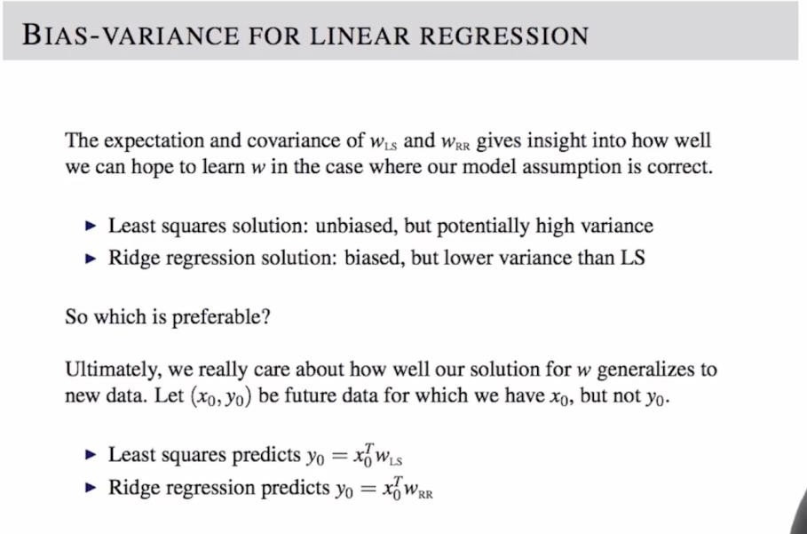
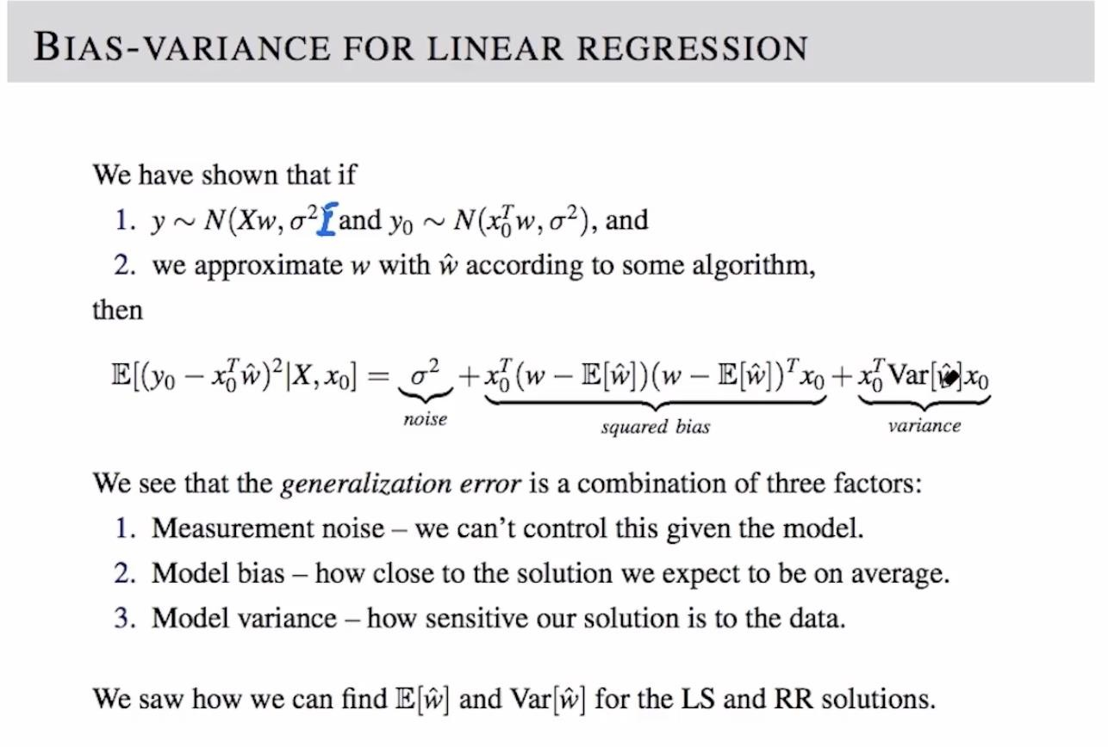
14.10-11 Bias-Variance Trade-Off I-II

Slide 11
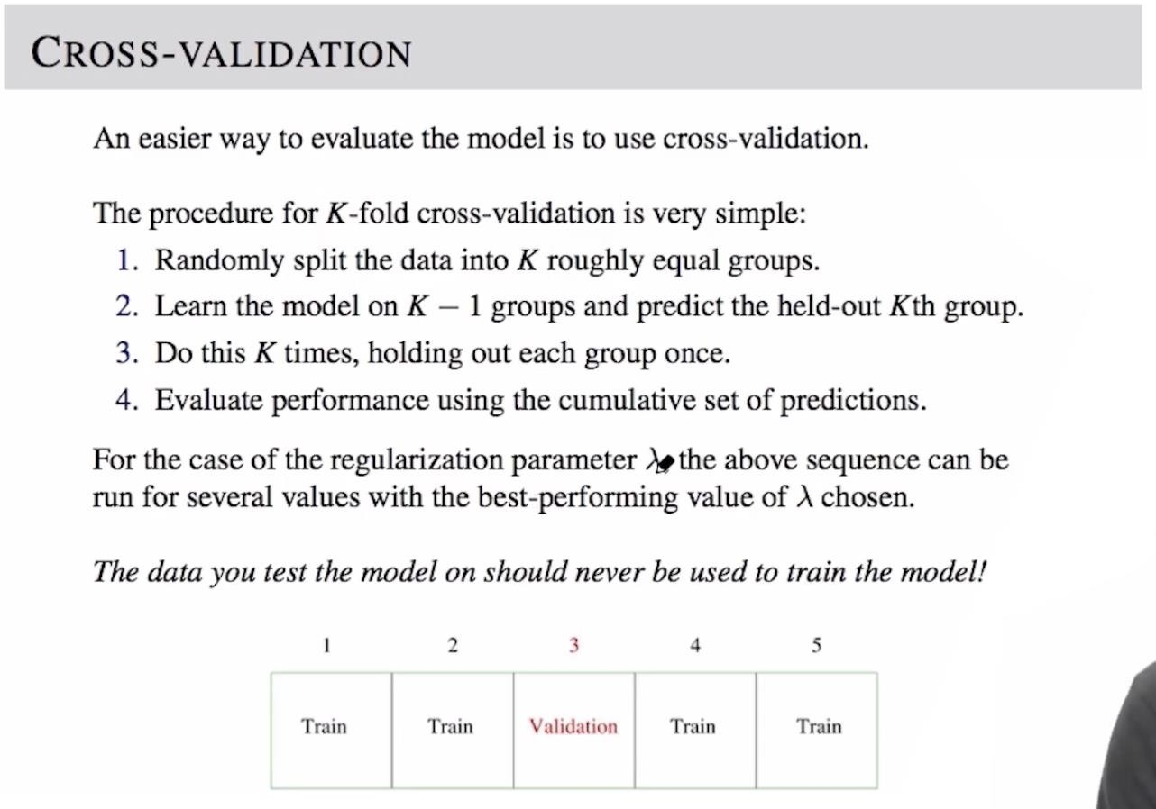
14.12 Cross Validation

Slide 12
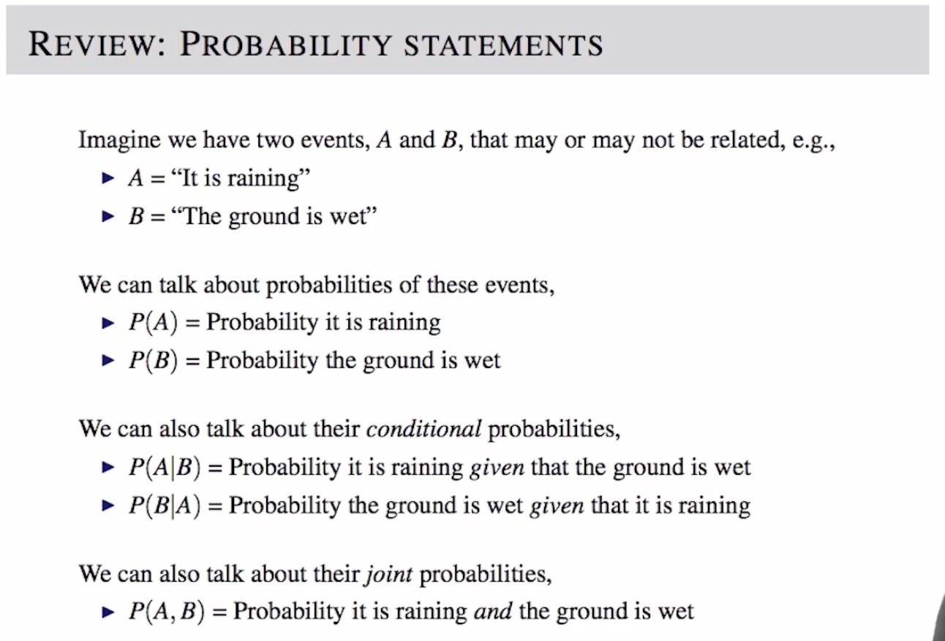
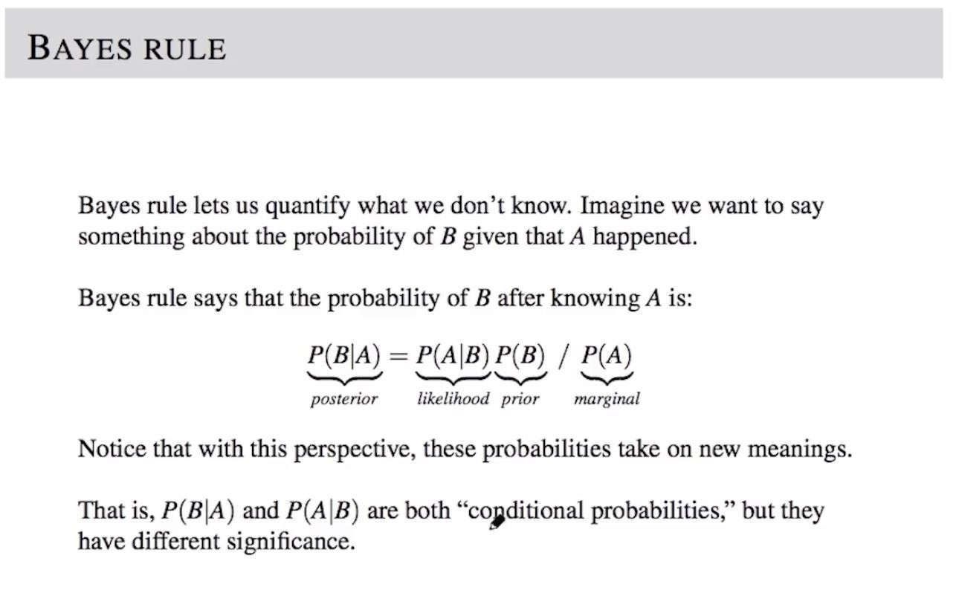
14.13 Bayes’ Rule

Slide 13
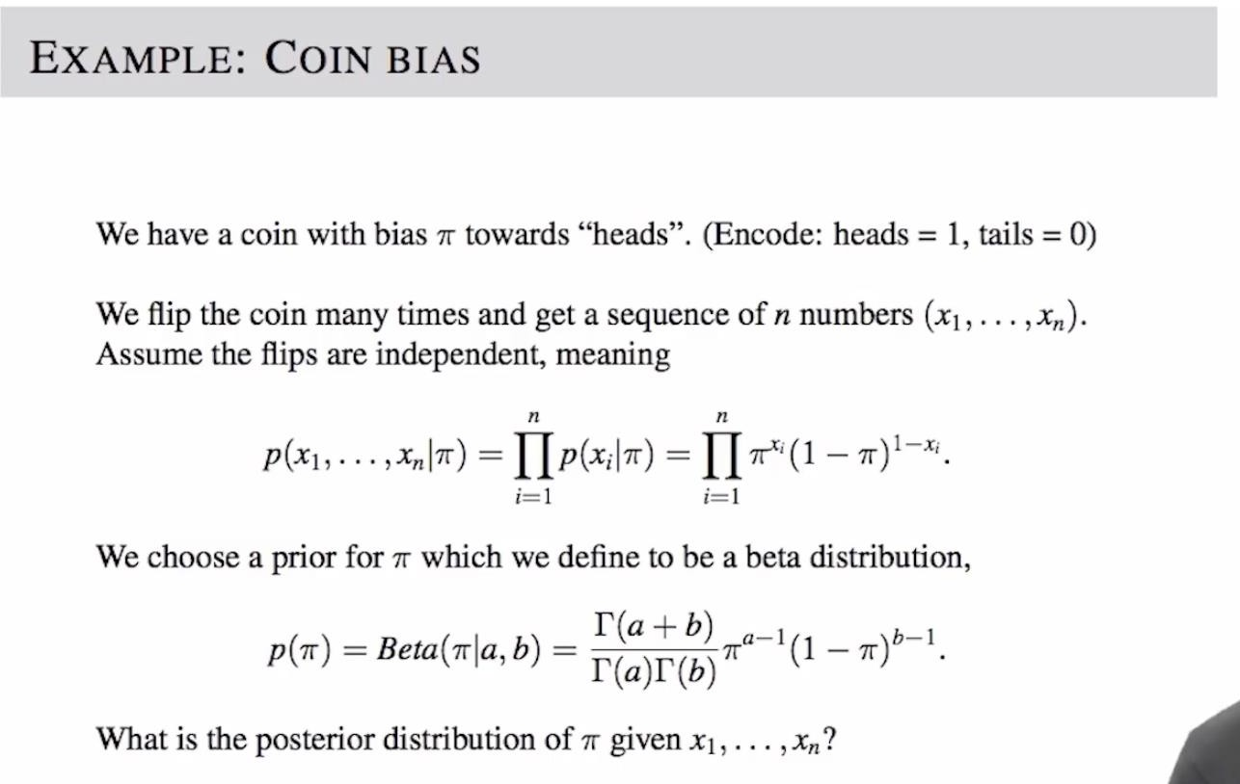
14.14 Coin Flipping Example

Slide 14
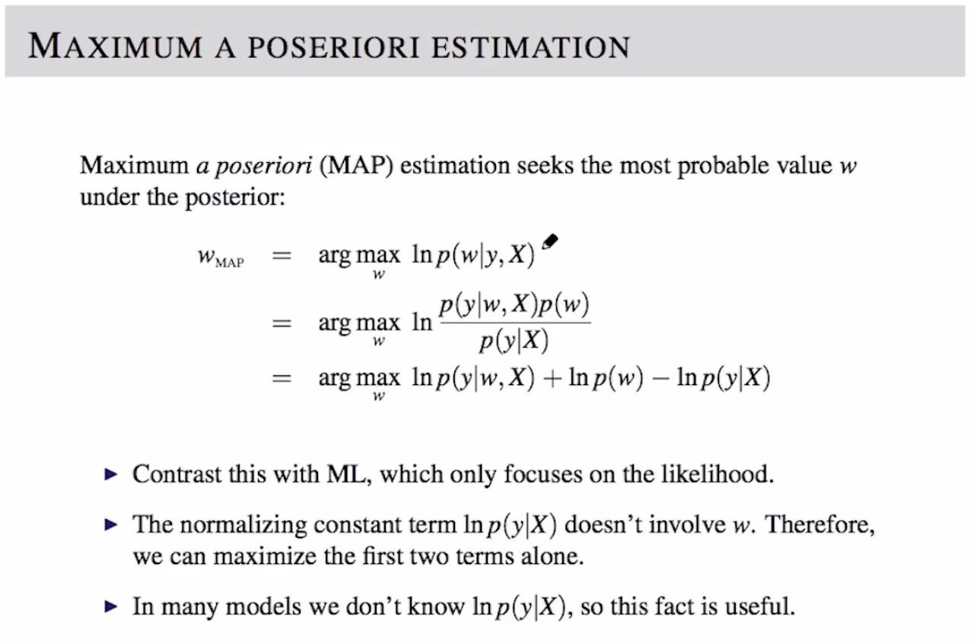
14.15 Maximum A Posteriori

Slide 15


Week 14 Office Hours
Week 14 Assignment

Slide 16
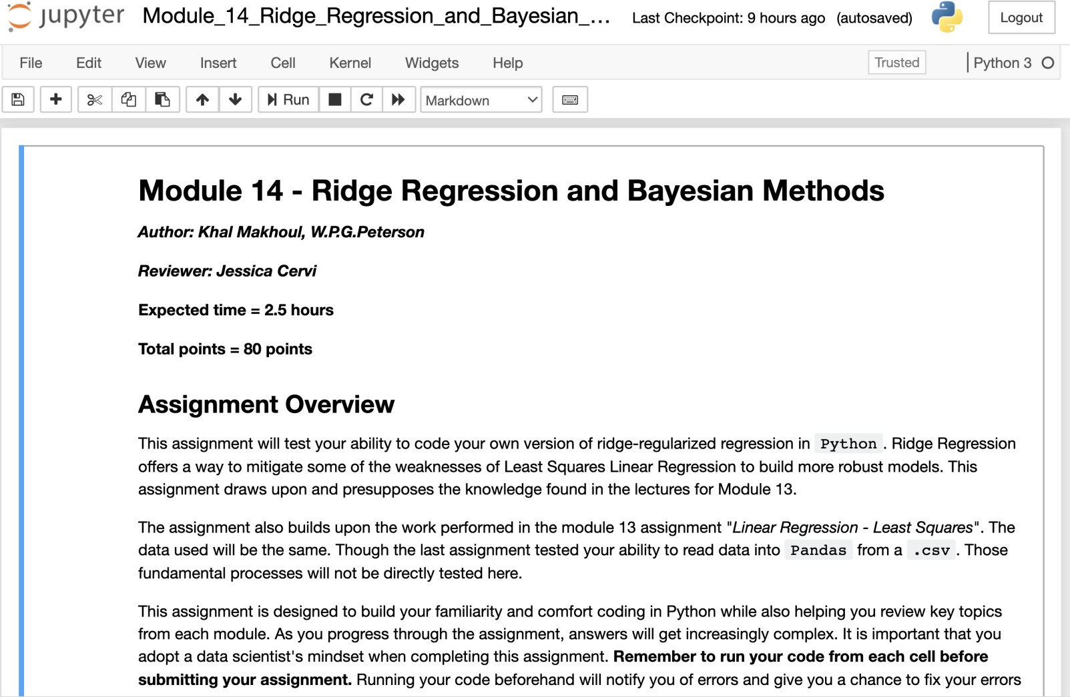
Module 14 – Ridge Regression and Bayesian Methods

Slide 17



Thank you
www.emeritus.org

